Slide 1
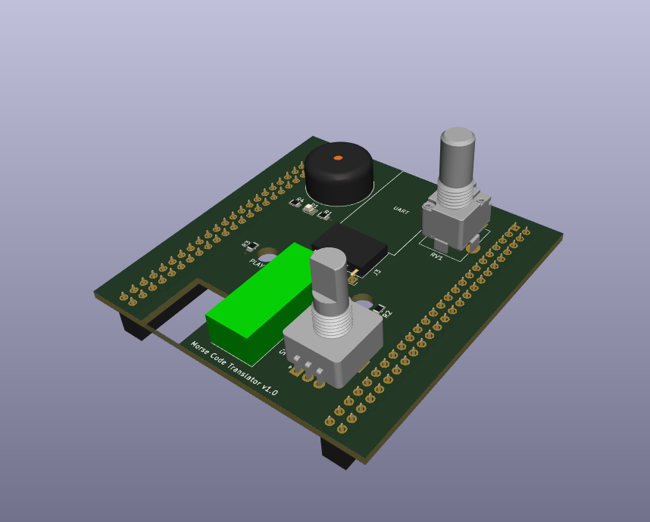
Morse Code Translator
Evan Hill

Slide 2
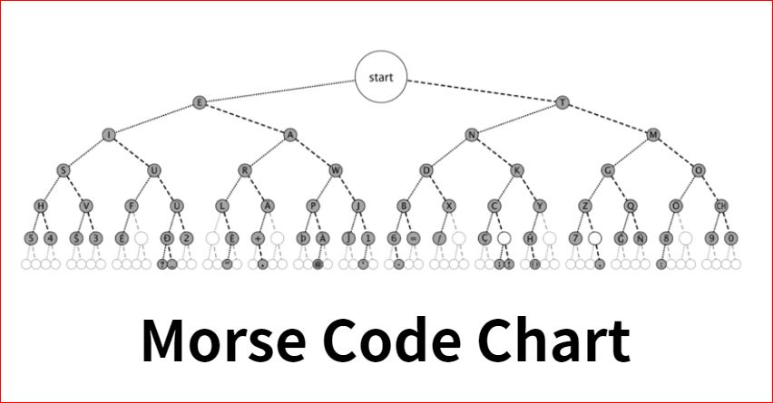

Slide 3
System Design
Specifications
Send a message through UART to translator, which will be played in Morse Code
Control volume of buzzer
LED blinks message regardless of buzzer volume
Displays letter equivalent
Can play selected letters on board
Components
STM32 Board
Buzzer + Potentiometer
LED
Display
UART
2 x Pushbuttons (Play and Reset)
Rotary Encoder

Slide 4
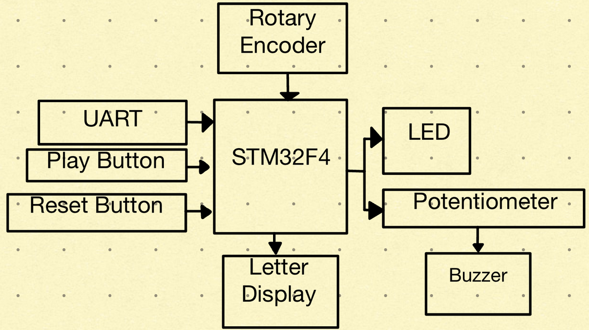
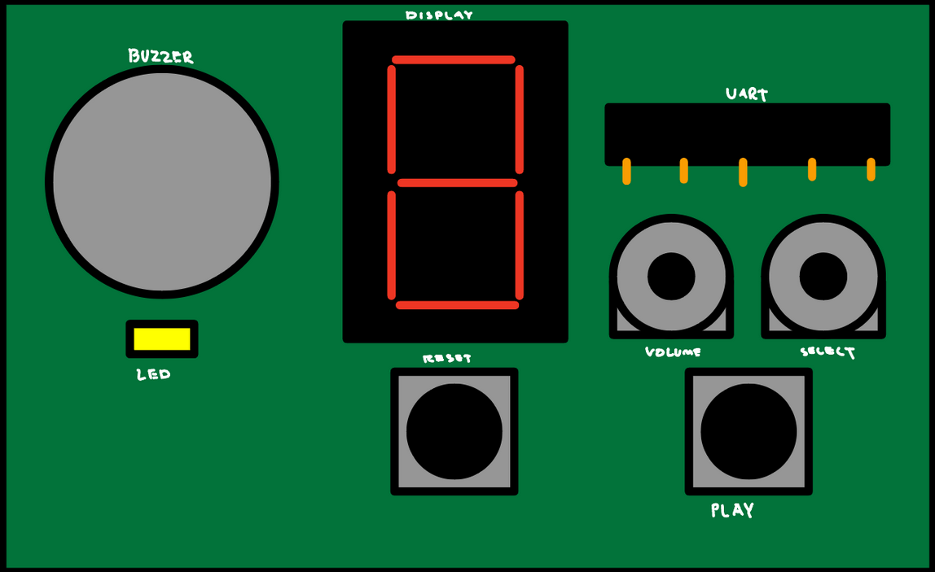
Design Diagram
Mock-Up

Slide 5
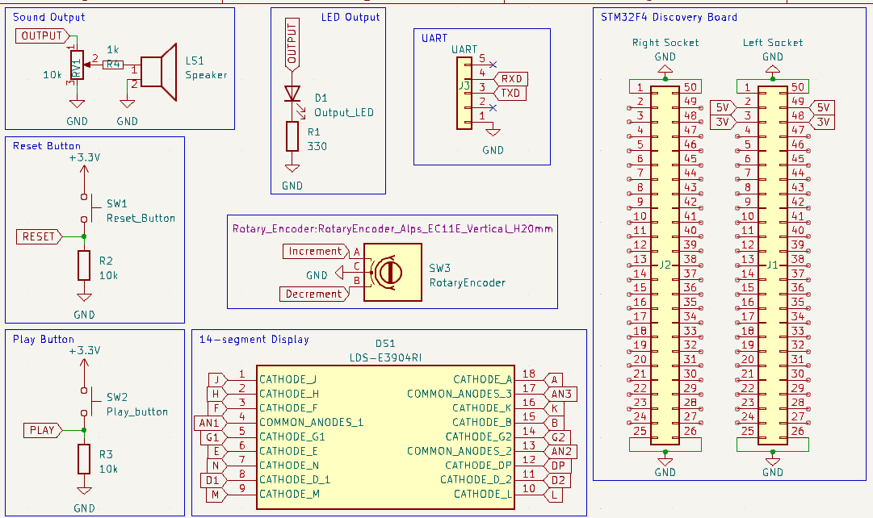
PCB Design - Schematic

Slide 6
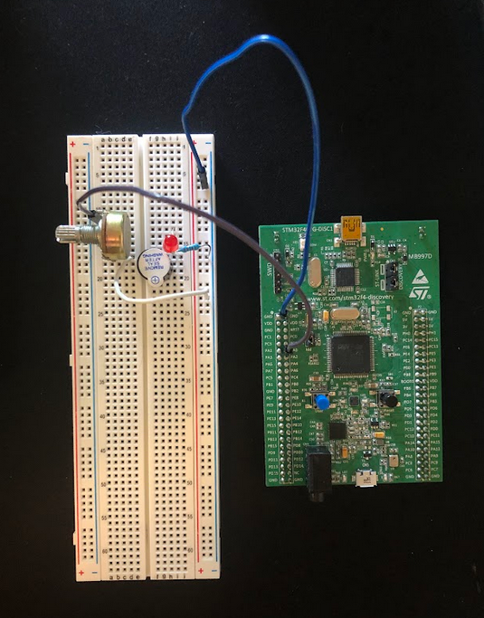
Prototype

Slide 7
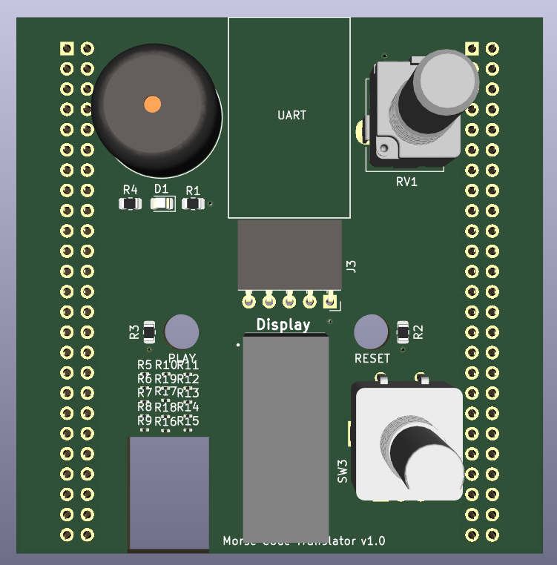
PCB Design – 3D Rendering
STM32 PCB Shield
TOP VIEW

Slide 8
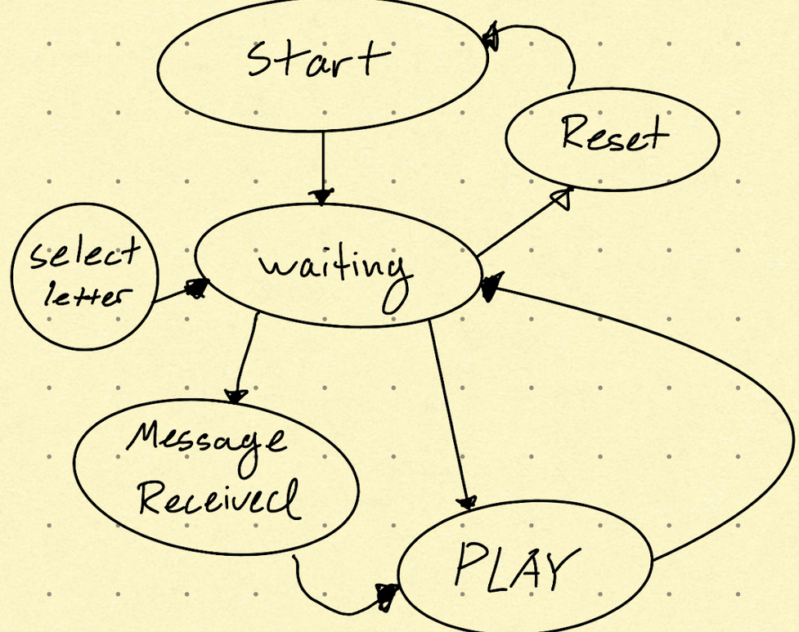
Software Development

